Slide 1
Name that tool
The power of tools to transform lives

Slide 2
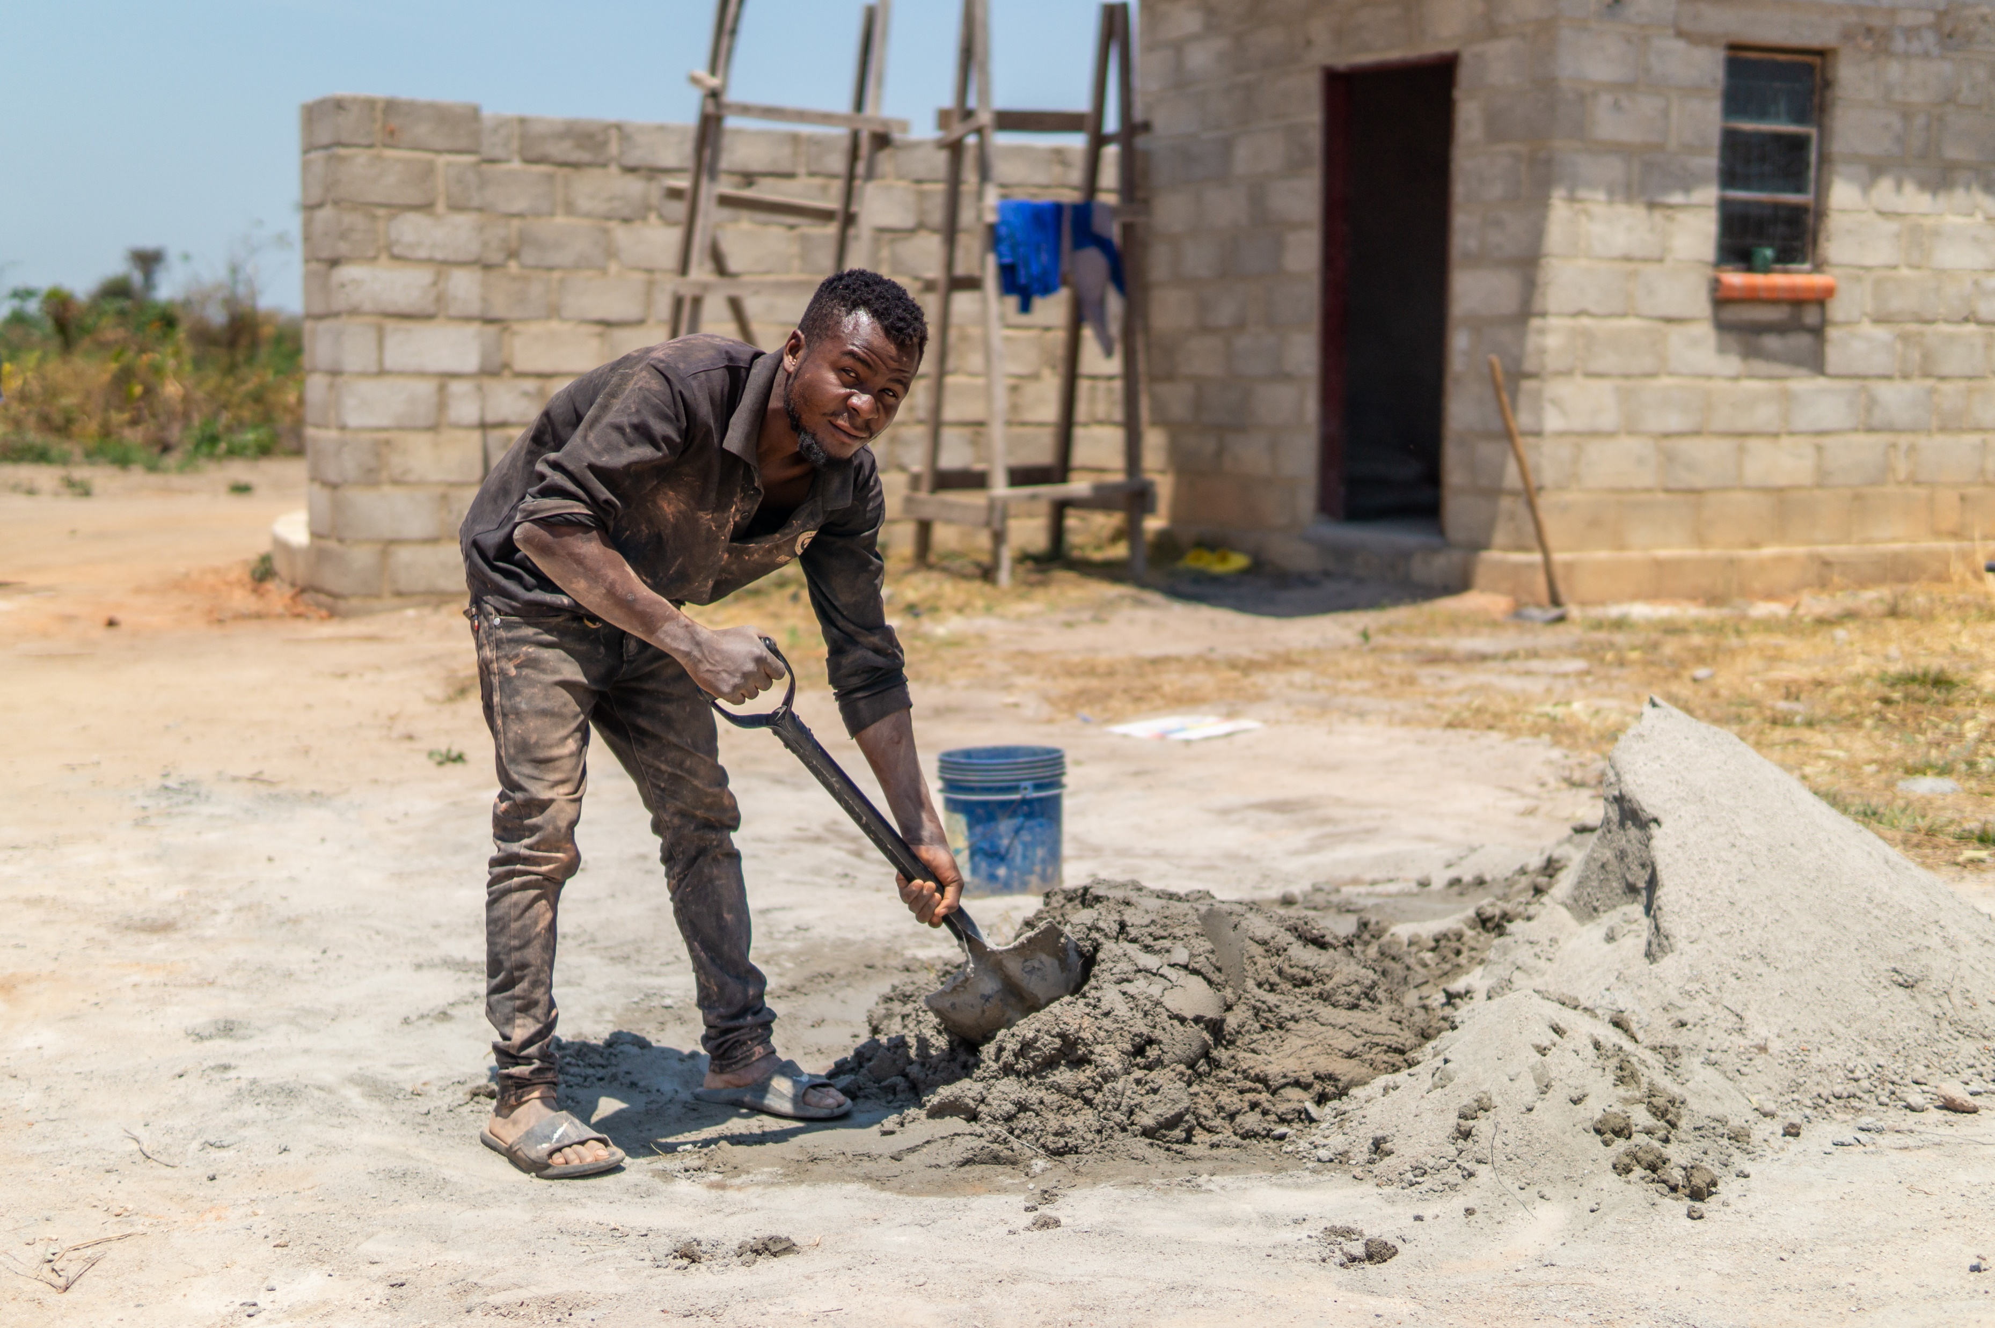
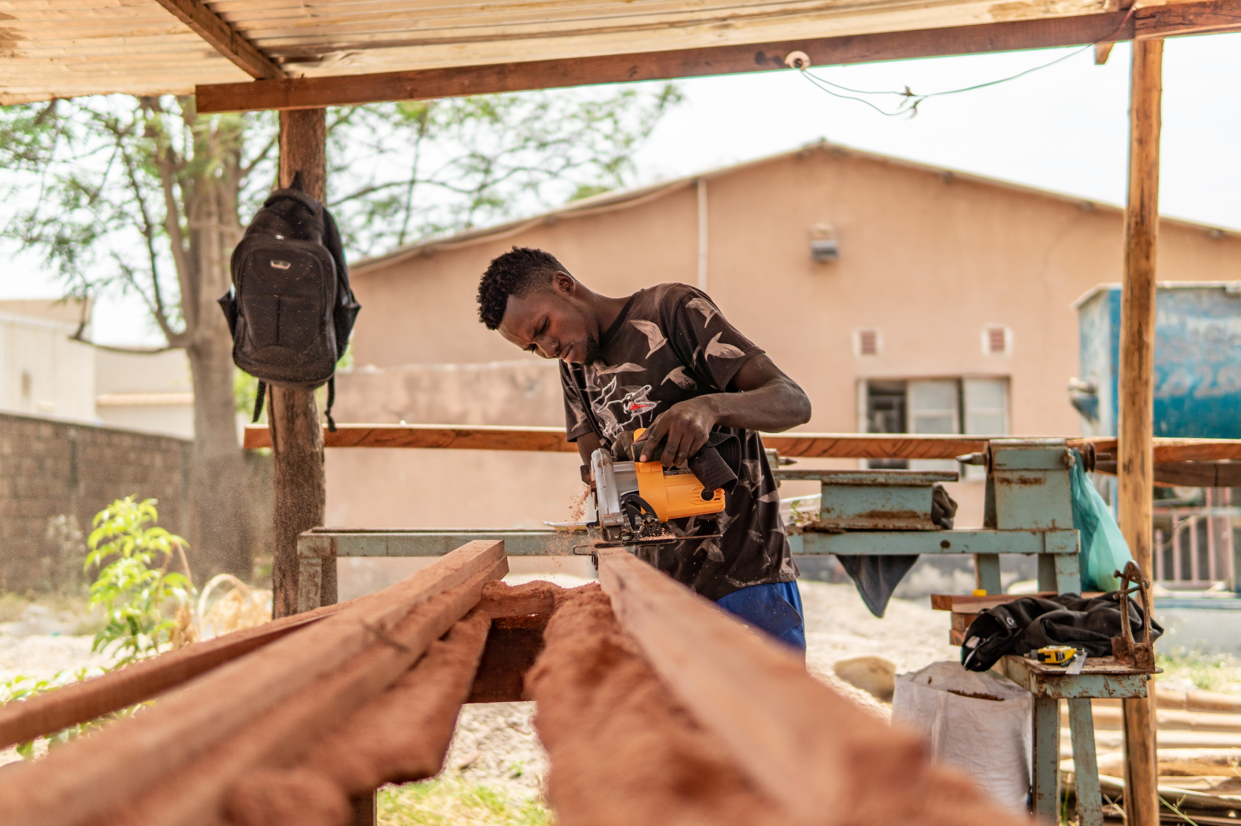
The power of tools to transform lives

Slide 3
Plumber
Mechanic
Builder
The power of tools to transform lives
Welder
Electrician

Slide 4
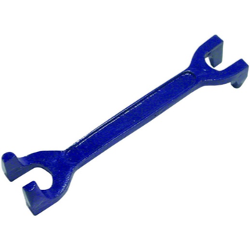
?
Plumber
Mechanic
The power of tools to transform lives
Builder
Electrician
Welder

Slide 5
Plumber
Plumber
Mechanic
The power of tools to transform lives
Builder
Electrician
Tap or basin wrench
Welder

Slide 6
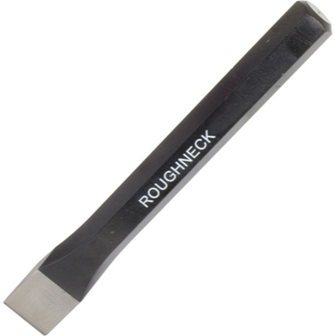
?
Plumber
Mechanic
The power of tools to transform lives
Builder
Electrician
Welder

Slide 7
Plumber
Builder
Mechanic
Mechanic
The power of tools to transform lives
Builder
Builder
Mechanic
Electrician
Cold chisel
Welder

Slide 8
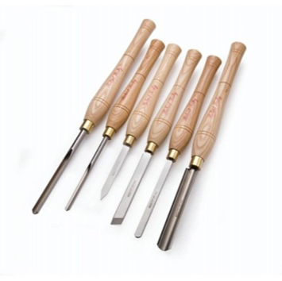
?
Plumber
Mechanic
The power of tools to transform lives
Builder
Electrician
Welder

Slide 9
Plumber
Mechanic
The power of tools to transform lives
Builder
Electrician
Wood turning chisels
Welder

Slide 10
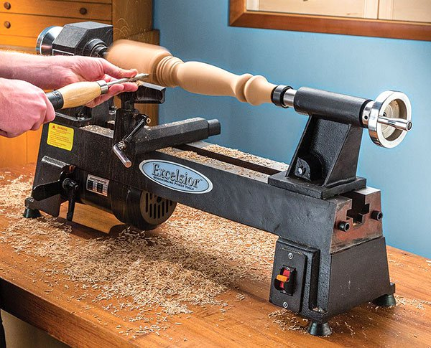
Plumber
Mechanic
The power of tools to transform lives
Builder
Electrician
Welder

Slide 11
?
Plumber
Mechanic
The power of tools to transform lives
Builder
Electrician
Welder

Slide 12
Plumber
Welder
Mechanic
The power of tools to transform lives
Builder
Electrician
G Clamp
Welder

Slide 13
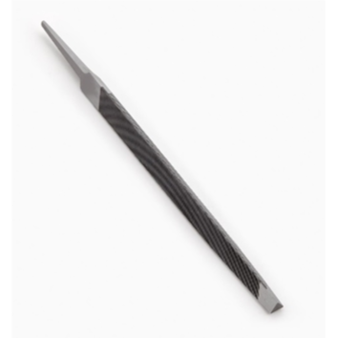
?
Plumber
Mechanic
The power of tools to transform lives
Builder
Electrician
Welder

Slide 14
Plumber
Mechanic
The power of tools to transform lives
Builder
Electrician
Triangular saw sharpening file
Welder

Slide 15
The power of tools to transform lives

Slide 16
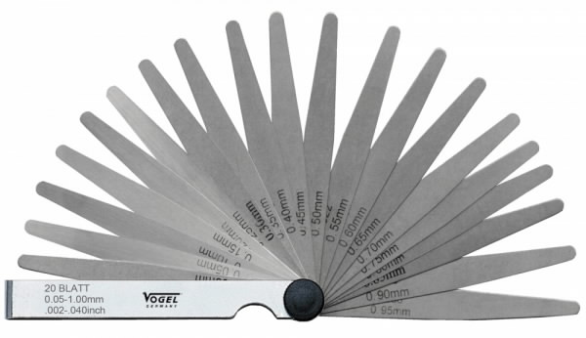
?
Plumber
Mechanic
The power of tools to transform lives
Builder
Electrician
Welder

Slide 17
Feeler gauge
Plumber
Mechanic
Mechanic
The power of tools to transform lives
Builder
Electrician
Welder

Slide 18
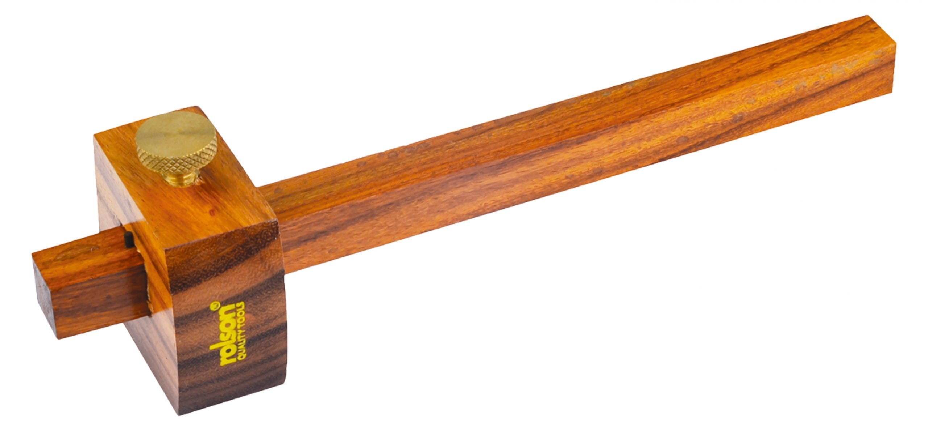
?
Plumber
Mechanic
The power of tools to transform lives
Builder
Electrician
Welder

Slide 19
Plumber
Mechanic
The power of tools to transform lives
Builder
Electrician
Marking gauge
Welder

Slide 20
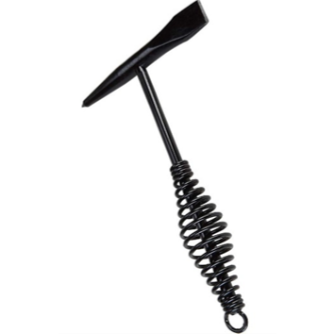
?
Plumber
Mechanic
The power of tools to transform lives
Builder
Electrician
Welder

Slide 21
Plumber
Welder
Mechanic
The power of tools to transform lives
Builder
Electrician
Chipping hammer
Welder

Slide 22
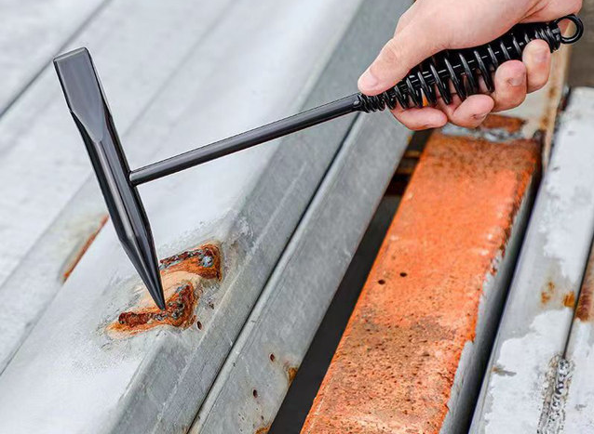
Plumber
Mechanic
The power of tools to transform lives
Builder
Electrician
Welder

Slide 23
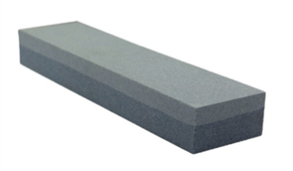
?
Plumber
Mechanic
The power of tools to transform lives
Builder
Electrician
Welder

Slide 24
Plumber
Mechanic
The power of tools to transform lives
Builder
Electrician
Two sided sharpening stone
Welder

Slide 25
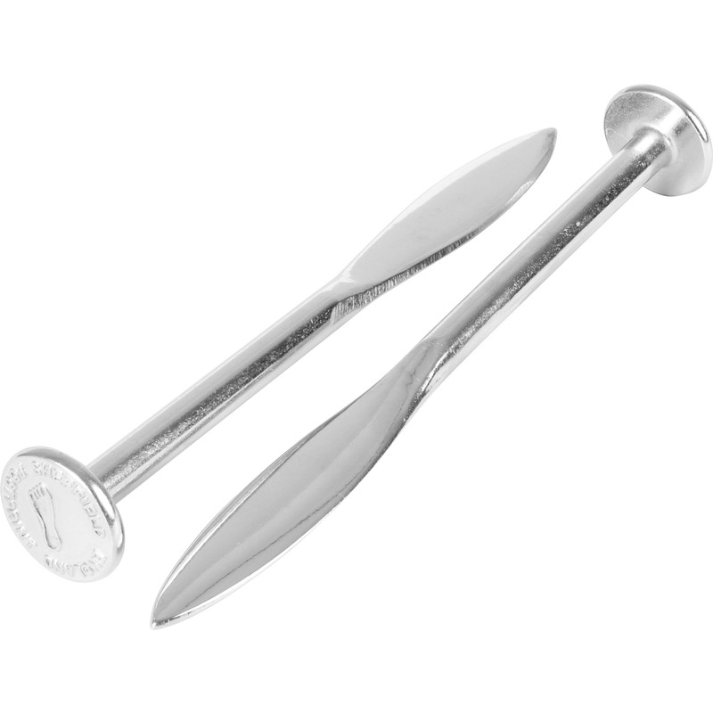
?
Plumber
Mechanic
The power of tools to transform lives
Builder
Electrician
Welder

Slide 26
Plumber
Builder
Mechanic
The power of tools to transform lives
Builder
Electrician
Pins (and line)
Welder

Slide 27
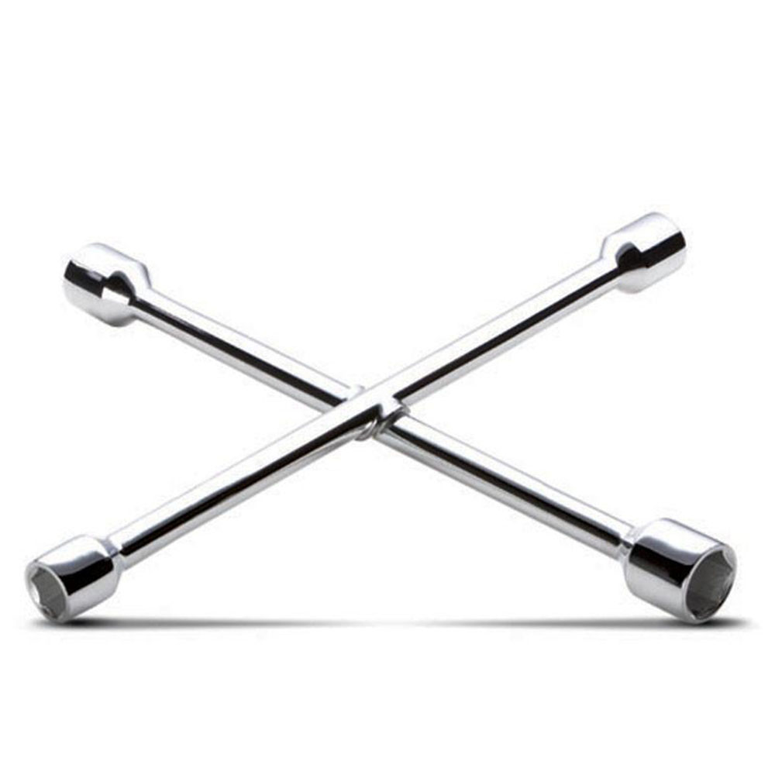
?
Plumber
Mechanic
The power of tools to transform lives
Builder
Electrician
Welder

Slide 28
4 way wheel wrench
Plumber
Mechanic
Mechanic
The power of tools to transform lives
Builder
Electrician
Welder

Slide 29
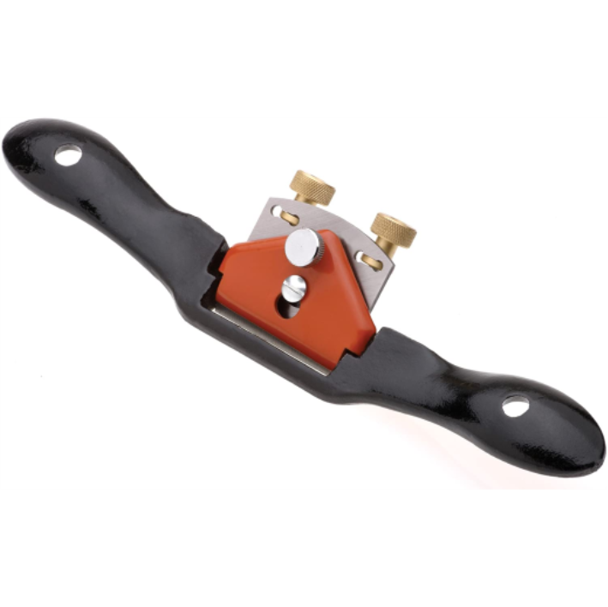
?
Plumber
Mechanic
The power of tools to transform lives
Builder
Electrician
Welder

Slide 30
Plumber
Mechanic
The power of tools to transform lives
Builder
Electrician
Spoke shave
Welder

Slide 31
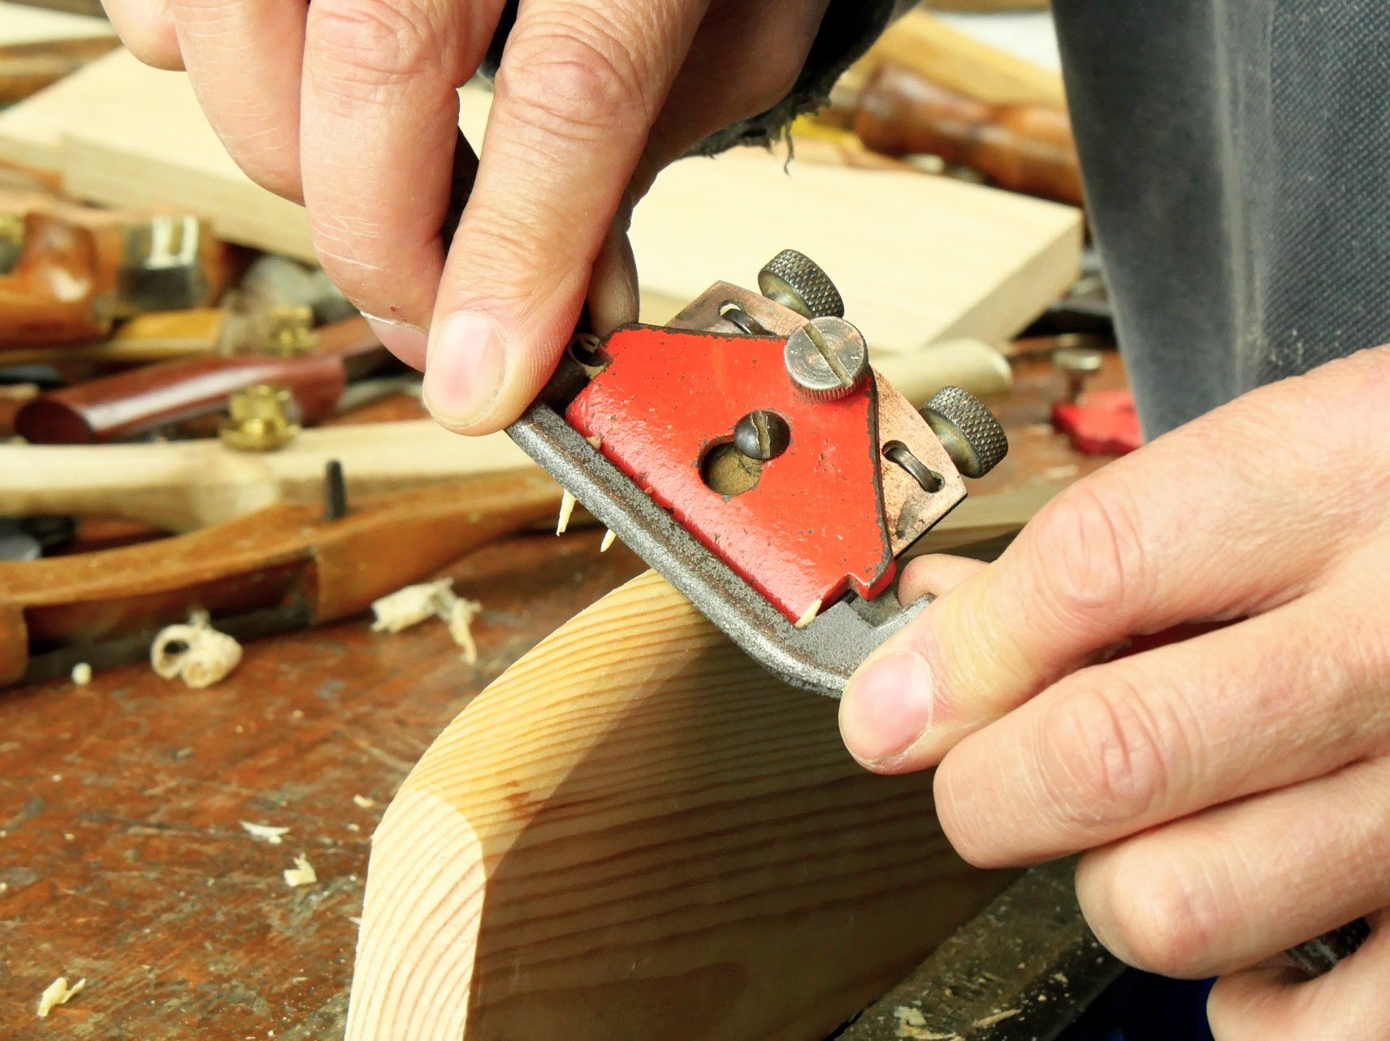
Plumber
Mechanic
The power of tools to transform lives
Builder
Electrician
Welder

Slide 32
?
Plumber
Mechanic
The power of tools to transform lives
Builder
Electrician
Welder

Slide 33
Combination square
Plumber
Mechanic
The power of tools to transform lives
Builder
Electrician
Welder

Slide 34
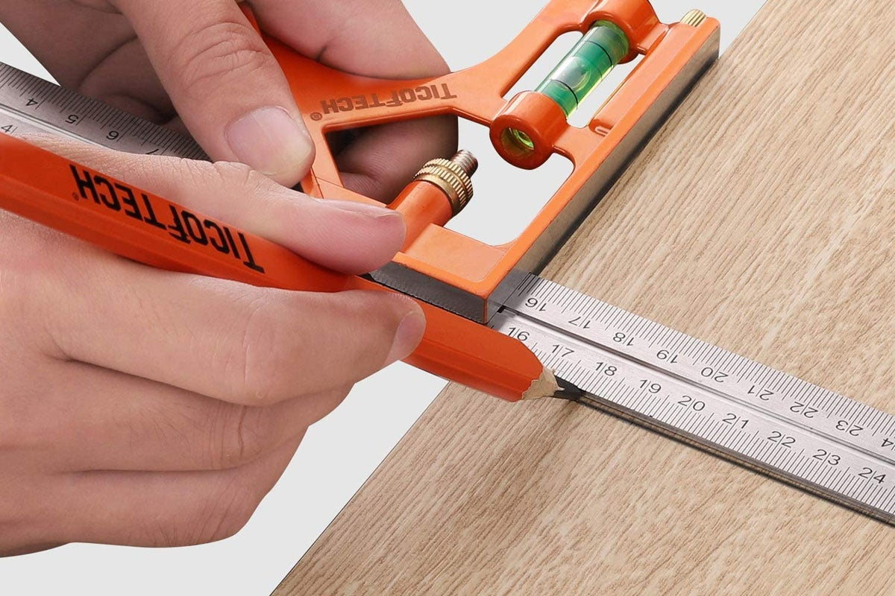
Plumber
Mechanic
The power of tools to transform lives
Builder
Electrician
Welder

Slide 35
13 correct
10 or above correct
6 or above correct
Under 6
Genuis level
Expert level
Experienced level
Good attempt
Plumber
Mechanic
The power of tools to transform lives
Builder
Electrician
Welder

Slide 36
Name that tool
The power of tools to transform lives

